Slide 1
Couchbase

Slide 2

Couchbase: Best Free NoSQL Cloud Database Platform
https://www.couchbase.com/

Slide 3
N1QL
N1QL Query Language Tutorial, Learn N1QL | Couchbase
https://query-tutorial.couchbase.com/tutorial/#1
N1QL (pronounced “nickel”) is Couchbase’s next-generation query language - aims to meet the query needs of distributed document-oriented databases
syntax and semantics of SELECT statement in N1QL

Slide 4
N1QL
Couchbase has developed an efficient way of retrieving documents using a SQL-like syntax, called N1QL
syntax is more or less like that of SQL
provides a way to query the JSON based document-oriented database
N1QL offers a data definition language (DDL), a data manipulation language (DML), and queries to extract information

Slide 5
1,2, CSimple.py
Python Couchbase with N1QL
import dataauth as da
# needed for any cluster connection
from couchbase.cluster import Cluster
from couchbase.auth import PasswordAuthenticator
# options for a cluster and SQL++ (N1QL) queries
from couchbase.options import ClusterOptions, QueryOptions

Slide 6
# get a reference to our cluste
cluster = Cluster.connect(da.servername, ClusterOptions(
PasswordAuthenticator(da.username, da.password)))
bucket_name = "travel-sample“
# get a reference to our bucket
cb = cluster.bucket('travel-sample')

Slide 7
1,2, CSimple.py
# using SQL++ (a.k.a N1QL)
call_sign = '%RO%’
sql_query = 'SELECT * FROM `travel-sample` WHERE type = "airline" AND callsign LIKE $1’
query_res = cluster.query(sql_query, QueryOptions(positional_parameters=[call_sign]))

Slide 8
1,2, CSimple.py
for row in query_res:
print(row)
# print(f'''{row["travel-sample"]["name"]} {row["travel-sample"]["callsign"]} from {row["travel-sample"]["country"]}'‘’)
python3 CSimple.py
{'travel-sample': {'callsign': 'CROWN AIRWAYS', 'country': 'United States', 'iata': None, 'icao': 'CRO', 'id': 1931, 'name': 'Crown Airways', 'type': 'airline'}}
{'travel-sample': {'callsign': 'FRONTIER FLIGHT', 'country': 'United States', 'iata': 'F9', 'icao': 'FFT', 'id': 2468, 'name': 'Frontier Airlines', 'type': 'airline'}}
{'travel-sample': {'callsign': 'FRONTIER-AIR', 'country': 'United States', 'iata': '2F', 'icao': 'FTA', 'id': 2470, 'name': 'Frontier Flying Service', 'type': 'airline'}}
{'travel-sample': {'callsign': 'REGIONAL EUROPE', 'country': 'France', 'iata': 'YS', 'icao': 'RAE', 'id': 4299, 'name': 'RÃ©gional', 'type': 'airline'}}

Slide 9
1,2, CSimple.py
for row in query_res:
# print(row)
print(f'''{row["travel-sample"]["name"]} {row["travel-sample"]["callsign"]} from {row["travel-sample"]["country"]}'‘’)
python3 CSimple.py
Crown Airways CROWN AIRWAYS from United States
Frontier Airlines FRONTIER FLIGHT from United States
Frontier Flying Service FRONTIER-AIR from United States
RÃ©gional REGIONAL EUROPE from France

Slide 10
N1QL
is SQL for JSON, a declarative query language for Couchbase's NoSQL database
query JSON documents like relational tables with familiar SQL syntax (SELECT, FROM, WHERE) but for flexible JSON data structures
powerful tool for data management and application development

Slide 11
SQL++
was formerly known as N1QL
SQL++ is Couchbase's powerful database language that combines Structured Query Language (SQL) with flexibility of JavaScript Object Notation (JSON), meeting the American National Standards Institute (ANSI) syntax guidelines
designed for developers, allows you to leverage existing skills to build modern applications

Slide 12
N1QL
SQL for JSON: brings SQL's power and familiarity to the world of document databases
Declarative: describe what data you want, not how to get it
JSON-Centric: works directly with JSON documents, allowing flexible schemas
Supports Joins, Aggregations, Full-text search, and Geospatial queries
bridges the gap between traditional SQL databases and modern NoSQL document stores

Slide 13
N1QL basics
N1QL aims to meet the query needs of distributed document-oriented databases
N1QL data model derives its name from the non-first normal form, which is a superset and generalization of the relational first normal form (1NF)

Slide 14
N1QL Statements
data definition language
data control language
data manipulation language

Slide 15
Data Definition Language
ALTER BUCKET
ALTER GROUP
ALTER INDEX
ALTER SEQUENCE
ALTER USER
ALTER VECTOR INDEX
BUILD INDEX
CREATE BUCKET
CREATE COLLECTION
CREATE FUNCTION
CREATE GROUP
CREATE INDEX
CREATE PRIMARY INDEX
CREATE SEQUENCE
CREATE SEQUENCE
CREATE SCOPE
CREATE USER
CREATE VECTOR INDEX
DROP BUCKET
DROP COLLECTION
DROP FUNCTION
DROP GROUP
DROP INDEX
DROP PRIMARY INDEX
DROP SEQUENCE
DROP SCOPE
DROP USER
DROP VECTOR INDEX

Slide 16
Data Control Language
statements enable to control which users or groups have access to data
GRANT
REVOKE

Slide 17
Data Manipulation Language
further categorized as data query language, transaction control language, or utility statements
DELETE
INSERT
MERGE
UPDATE
UPSERT

Slide 18
Data Query Language
  SELECT
Transaction Control Language
  BEGIN TRANSACTION
  COMMIT TRANSACTION
  ROLLBACK TRANSACTION
  SAVEPOINT
  SET TRANSACTION

Slide 19
Utility Statements
do not manipulate data directly, but support other operations
ADVISE
EXECUTE
EXECUTE FUNCTION
EXPLAIN
EXPLAIN FUNCTION
INFER
PREPARE
UPDATE STATISTICS
USING AI

Slide 20
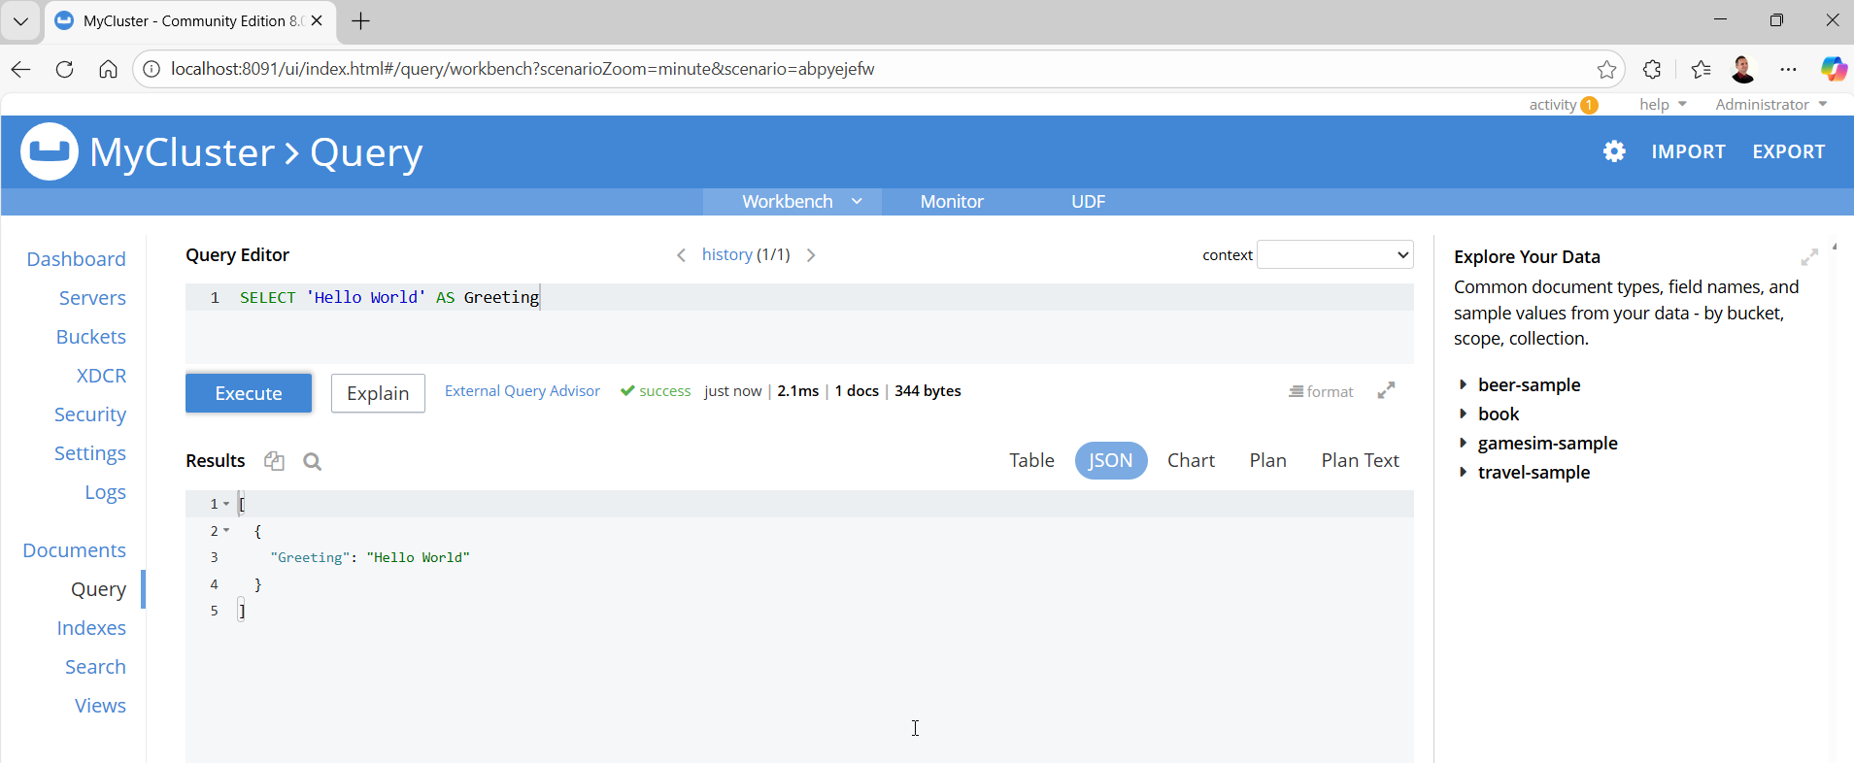
N1QL Query

Slide 21
user-friendly language, especially if you are familiar with SQL
SELECT — parts of document to return
FROM — data bucket, or data store to work with
WHERE — conditions the document must satisfy

Slide 22
wildcard * selects all top-level fields of document
queries can return a collection of different document structures or fragments, however they will all match the conditions in WHERE clause - there is no schema in Couchbase, N1QL return all results that match condition query, even if they vary in structure
change the * to document field such you will see query return a collection of appropriate fragments of each document

Slide 23
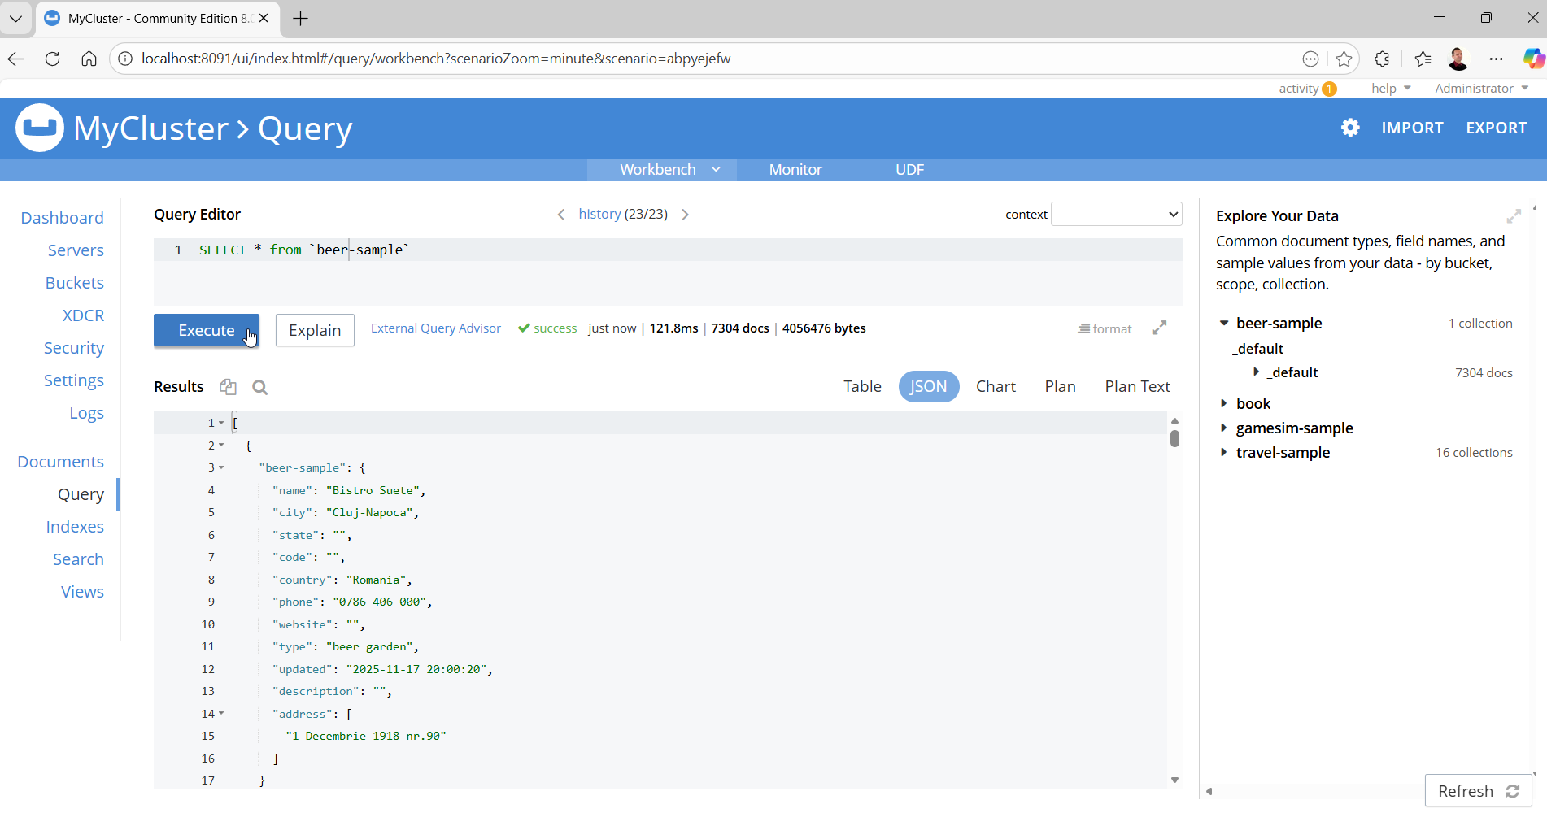

Slide 24
SELECT * FROM `beer-sample`
it is not ‘ ; it is not ‘ ; it must be `

Slide 25
SELECT * FROM `travel-sample`
current dataset, 95436932 bytes, is too large to display quickly.
Using a lower limit or a more specific where clause in your query can reduce result size. Rendering might freeze your browser for 23 to 92 seconds or more.

Slide 26
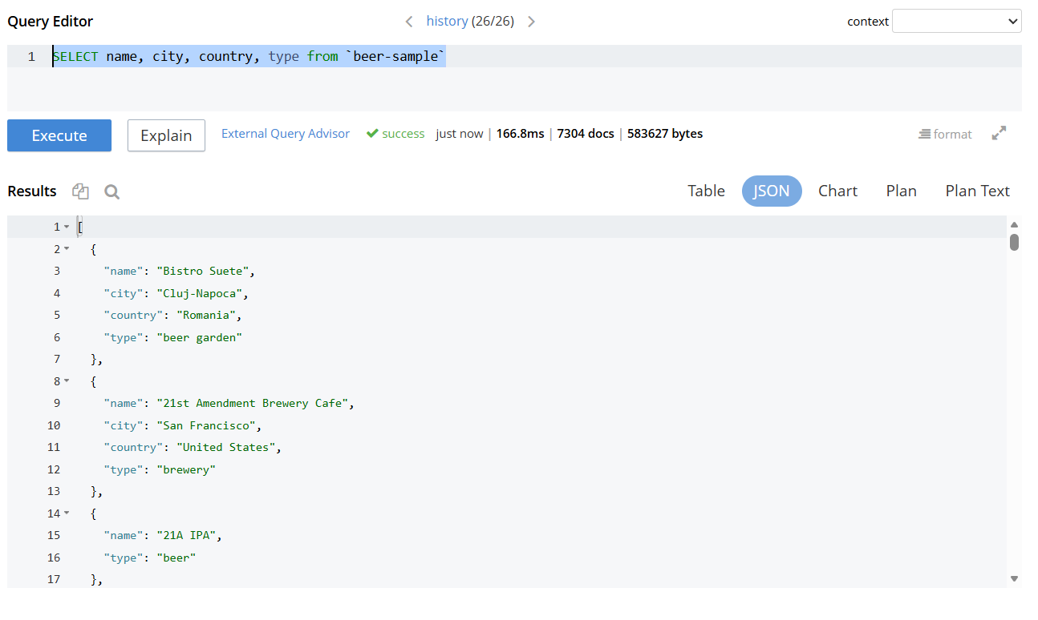
SELECT name, city, country, type
FROM `beer-sample`

Slide 27
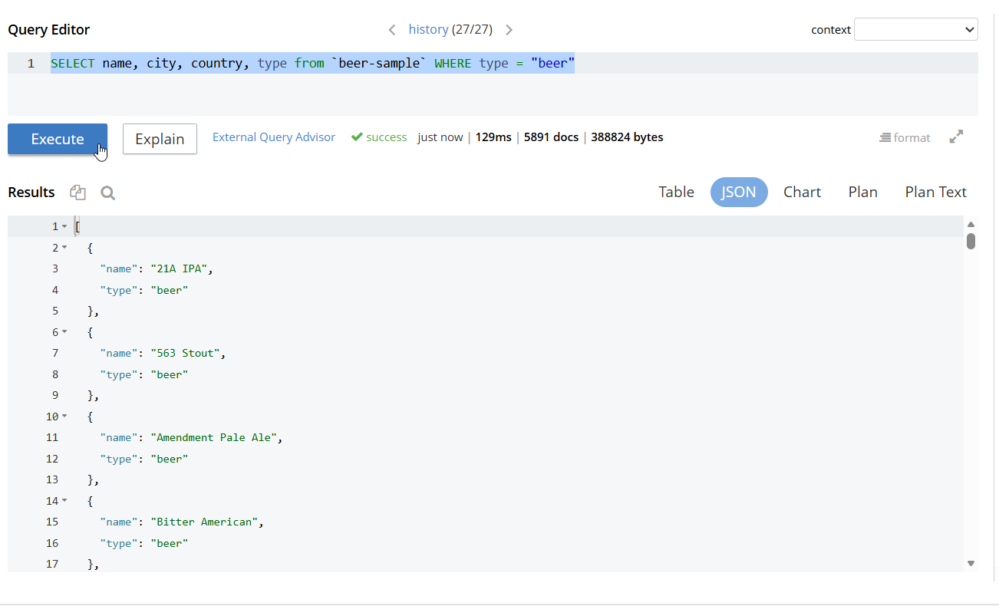
SELECT name, city, country, type
FROM `beer-sample` WHERE type = "beer"

Slide 28
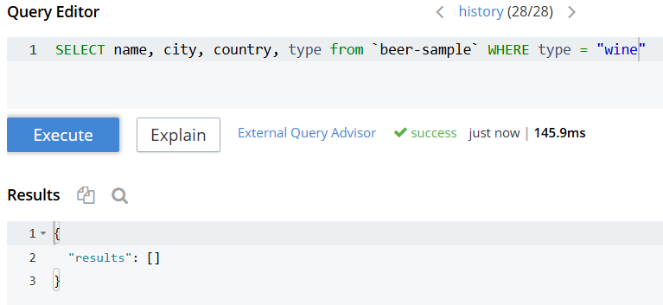

Slide 29
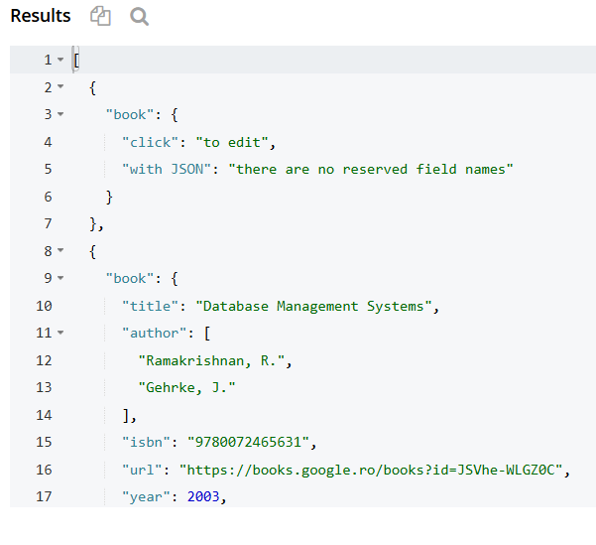
SELECT * FROM `book`

Slide 30
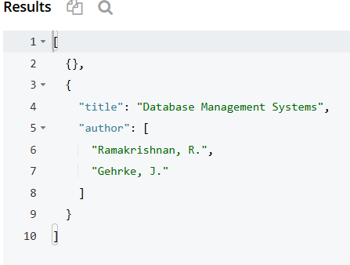
SELECT title, author FROM `book`

Slide 31
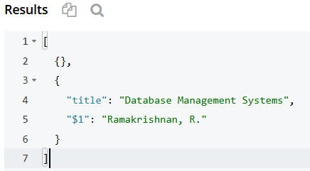
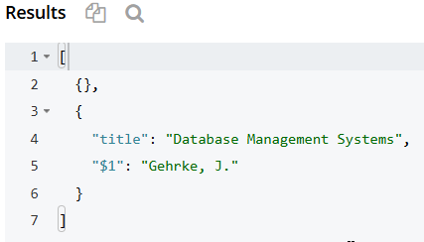
Attributes from child documents must be explicitly aliased using AS clause
SELECT title, author[0] FROM `book`
SELECT title, author[1] FROM `book`

Slide 32
N1QL is for JSON documents, not relational table, rows or columns
JSON documents can have nested elements and embedded arrays, additional operators are needed
the ‘.’ operator is used to refer to children
the ‘[]’ is used to refer to element in array

Slide 33
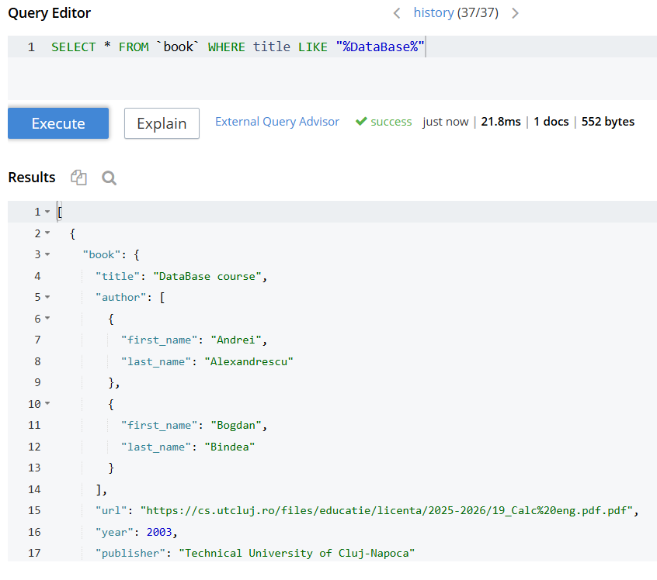
SELECT * FROM `book`
WHERE title
LIKE "%DataBase%"

Slide 34
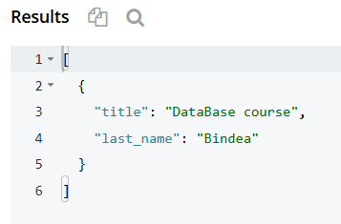
SELECT title, author[1].last_name
FROM`book` WHERE title LIKE "%DataBase%"

Slide 35
string matching can be accomplished using LIKE operator
in patterns % is a wildcard that matches zero or more characters, and _ is a wildcard that matches exactly one character

Slide 36
sometimes you want to filter based on arrays nested inside document

Slide 37
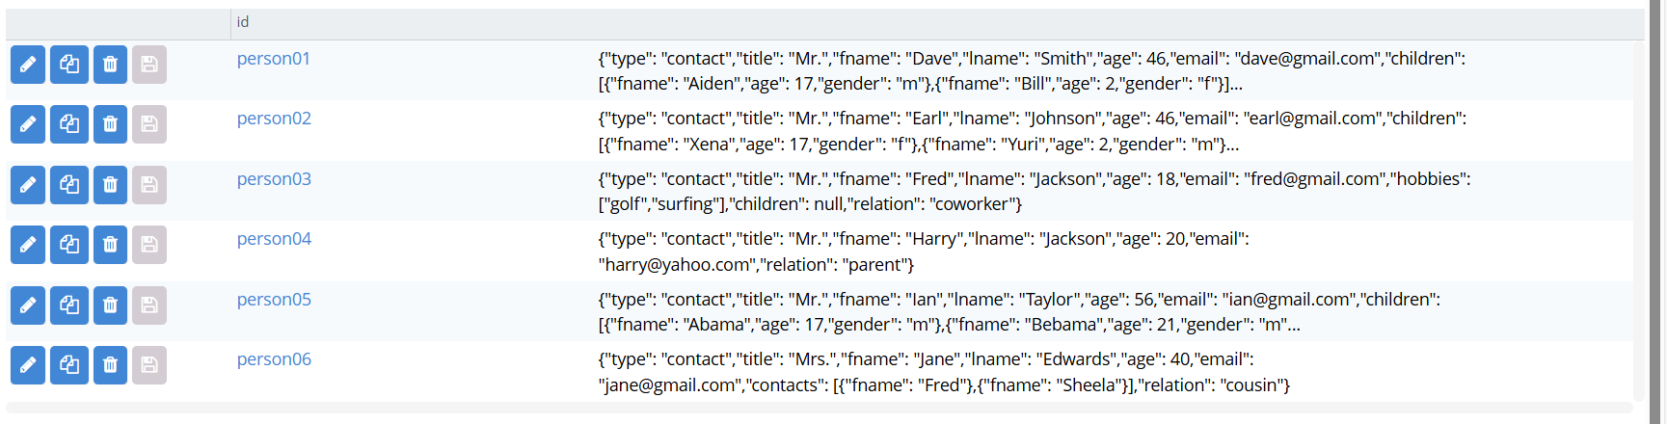

Slide 38
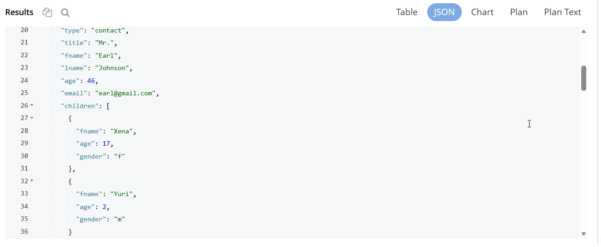
SELECT * from `tutorial`

Slide 39
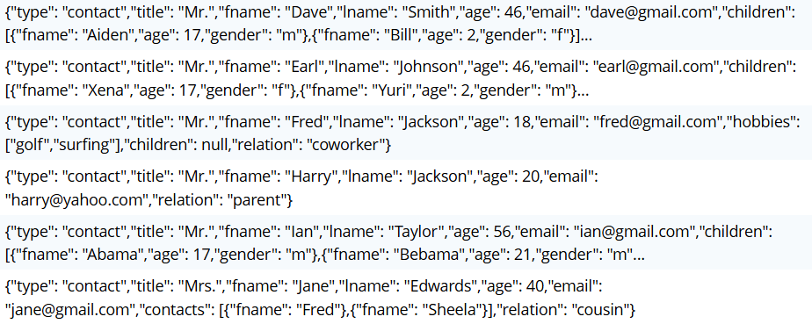

Slide 40
in tutorial dataset, some documents contain an array of children, and each child has a name and an age
to find any person that has a child over the age of 10:
can be achieved using the ANY/EVERY - SATISFIES construct
expression after the ANY clause allows us to assign name to element in array that we are searching through
the SATISFIES keyword is used to specify the filter condition
can try change ANY to EVERY

Slide 41
SELECT fname, children
FROM tutorial
WHERE ANY child IN tutorial.children SATISFIES child.age > 10 END

Slide 42
[ { "fname": "Dave",
"children": [ { "age": 17, "fname": "Aiden", "gender": "m" }, { "age": 2, "fname": "Bill", "gender": "f" } ] },
{ "fname": "Earl",
"children": [ { "age": 17, "fname": "Xena", "gender": "f" }, { "age": 2, "fname": "Yuri", "gender": "m" } ] },
{ "fname": "Ian",
"children": [ { "age": 17, "fname": "Abama", "gender": "m" }, { "age": 21, "fname": "Bebama", "gender": "m" } ] }]

Slide 43
SELECT fname, children FROM tutorial
WHERE ANY child IN tutorial.children SATISFIES child.age > 10 END
[ { "fname": "Ian",
"children": [ { "age": 17, "fname": "Abama", "gender": "m" }, { "age": 21, "fname": "Bebama", "gender": "m" } ] }]

Slide 44
Combining multiple conditions with
AND OR NOT
operators AND OR allows to match documents satisfying two or more conditions

Slide 45
Querying primary keys
specific primary keys within a bucket can be queried using USE KEYS clause
SELECT fname, email
FROM tutorial
USE KEYS ["person02", "person04"]
[ { "fname": "Earl", "email": "earl@gmail.com" },
{ "fname": "Harry", "email": "harry@yahoo.com" }]

Slide 46
SELECT fname || " " || lname AS full_name, email, children[0:2] AS offspring
FROM tutorial
WHERE email LIKE '%@yahoo.com'
OR ANY child IN tutorial.children SATISFIES child.age > 10 END

Slide 47
Pagination with LIMIT and OFFSET
sometimes queries return large number of results, and you want to process them in smaller batches; after processing smaller batch, want to skip over a batch to process next one
adding OFFSET n and LIMIT m
SELECT * FROM `travel-sample` LIMIT 20 OFFSET (5 - 1) * 20
page 5, 50 items / records on page

Slide 48
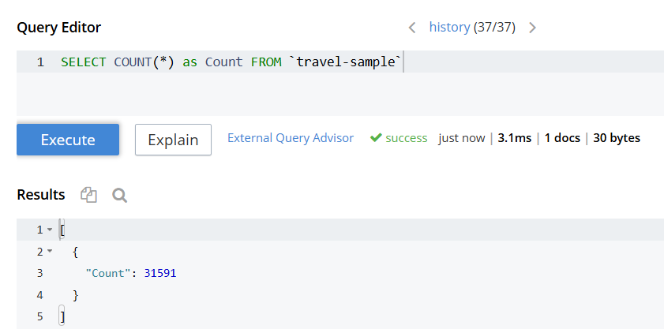
SELECT COUNT(*) as Count FROM `travel-sample`

Slide 49
SELECT type, COUNT(*) as Count FROM `travel-sample` GROUP BY type
[
{ "type": "airline", "Count": 187 },
{ "type": "airport", "Count": 1968 },
{ "type": "hotel", "Count": 917 },
{ "type": "landmark", "Count": 4495 },
{ "type": "route", "Count": 24024 }
]

Slide 50
Filtering grouped data with HAVING
sometimes you want to filter which groups are returned
similar to filtering documents with the WHERE clause, can filter groups with HAVING clause

Slide 51
UNNEST clause
creates input object by flattening array in parent document
used within the FROM clause
if document or object contains a nested array, UNNEST conceptually performs a join of the nested array with its parent object; each resulting joined object becomes output of query
UnNests can be chained
to return position of elements in unnested array after you use UNNEST, use UNNEST_POS function

Slide 52
SELECT * FROM tutorial person
[ { "person": { "type": "contact", "title": "Mr.", "fname": "Fred", "lname": "Jackson", "age": 18, "email": "fred@gmail.com", "hobbies": [ "golf", "surfing" ], "children": null, "relation": "coworker" } },
{ "person": { "type": "contact", "title": "Mr.", "fname": "Earl", "lname": "Johnson", "age": 46, "email": "earl@gmail.com", "children": [ { "fname": "Xena", "age": 17, "gender": "f" }, { "fname": "Yuri", "age": 2, "gender": "m" } ], "hobbies": [ "surfing" ], "relation": "friend" } },
{ "person": { "type": "contact", "title": "Mr.", "fname": "Dave", "lname": "Smith", "age": 46, "email": "dave@gmail.com", "children": [ { "fname": "Aiden", "age": 17, "gender": "m" }, { "fname": "Bill", "age": 2, "gender": "f" } ], "hobbies": [ "golf", "surfing" ], "relation": "friend" } },
{ "person": { "type": "contact", "title": "Mr.", "fname": "Ian", "lname": "Taylor", "age": 56, "email": "ian@gmail.com", "children": [ { "fname": "Abama", "age": 17, "gender": "m" }, { "fname": "Bebama", "age": 21, "gender": "m" } ], "hobbies": [ "golf", "surfing" ], "relation": "cousin" } },
{ "person": { "type": "contact", "title": "Mrs.", "fname": "Jane", "lname": "Edwards", "age": 40, "email": "jane@gmail.com", "contacts": [ { "fname": "Fred" }, { "fname": "Sheela" } ], "relation": "cousin" } },
{ "person": { "type": "contact", "title": "Mr.", "fname": "Harry", "lname": "Jackson", "age": 20, "email": "harry@yahoo.com", "relation": "parent" } }]

Slide 53
SELECT * FROM tutorial person
UNNEST person.children child
[ { "child": { "fname": "Xena", "age": 17, "gender": "f" }, "person": { "type": "contact", "title": "Mr.", "fname": "Earl", "lname": "Johnson", "age": 46, "email": "earl@gmail.com", "children": [ { "fname": "Xena", "age": 17, "gender": "f" }, { "fname": "Yuri", "age": 2, "gender": "m" } ], "hobbies": [ "surfing" ], "relation": "friend" } },
{ "child": { "fname": "Yuri", "age": 2, "gender": "m" }, "person": { "type": "contact", "title": "Mr.", "fname": "Earl", "lname": "Johnson", "age": 46, "email": "earl@gmail.com", "children": [ { "fname": "Xena", "age": 17, "gender": "f" }, { "fname": "Yuri", "age": 2, "gender": "m" } ], "hobbies": [ "surfing" ], "relation": "friend" } },
{ "child": { "fname": "Abama", "age": 17, "gender": "m" }, "person": { "type": "contact", "title": "Mr.", "fname": "Ian", "lname": "Taylor", "age": 56, "email": "ian@gmail.com", "children": [ { "fname": "Abama", "age": 17, "gender": "m" }, { "fname": "Bebama", "age": 21, "gender": "m" } ], "hobbies": [ "golf", "surfing" ], "relation": "cousin" } },
{ "child": { "fname": "Bebama", "age": 21, "gender": "m" }, "person": { "type": "contact", "title": "Mr.", "fname": "Ian", "lname": "Taylor", "age": 56, "email": "ian@gmail.com", "children": [ { "fname": "Abama", "age": 17, "gender": "m" }, { "fname": "Bebama", "age": 21, "gender": "m" } ], "hobbies": [ "golf", "surfing" ], "relation": "cousin" } },
{ "child": { "fname": "Aiden", "age": 17, "gender": "m" }, "person": { "type": "contact", "title": "Mr.", "fname": "Dave", "lname": "Smith", "age": 46, "email": "dave@gmail.com", "children": [ { "fname": "Aiden", "age": 17, "gender": "m" }, { "fname": "Bill", "age": 2, "gender": "f" } ], "hobbies": [ "golf", "surfing" ], "relation": "friend" } },
{ "child": { "fname": "Bill", "age": 2, "gender": "f" }, "person": { "type": "contact", "title": "Mr.", "fname": "Dave", "lname": "Smith", "age": 46, "email": "dave@gmail.com", "children": [ { "fname": "Aiden", "age": 17, "gender": "m" }, { "fname": "Bill", "age": 2, "gender": "f" } ], "hobbies": [ "golf", "surfing" ], "relation": "friend" } }]

Slide 54
SELECT UNNEST_POS(child) + 1 as child_no,*
FROM tutorial person UNNEST person.children child

Slide 55
[ { "child_no": 1, "child": { "fname": "Abama", "age": 17, "gender": "m" }, "person": { "type": "contact", "title": "Mr.", "fname": "Ian", "lname": "Taylor", "age": 56, "email": "ian@gmail.com", "children": [ { "fname": "Abama", "age": 17, "gender": "m" }, { "fname": "Bebama", "age": 21, "gender": "m" } ], "hobbies": [ "golf", "surfing" ], "relation": "cousin" } },
{ "child_no": 2, "child": { "fname": "Bebama", "age": 21, "gender": "m" }, "person": { "type": "contact", "title": "Mr.", "fname": "Ian", "lname": "Taylor", "age": 56, "email": "ian@gmail.com", "children": [ { "fname": "Abama", "age": 17, "gender": "m" }, { "fname": "Bebama", "age": 21, "gender": "m" } ], "hobbies": [ "golf", "surfing" ], "relation": "cousin" } },
{ "child_no": 1, "child": { "fname": "Aiden", "age": 17, "gender": "m" }, "person": { "type": "contact", "title": "Mr.", "fname": "Dave", "lname": "Smith", "age": 46, "email": "dave@gmail.com", "children": [ { "fname": "Aiden", "age": 17, "gender": "m" }, { "fname": "Bill", "age": 2, "gender": "f" } ], "hobbies": [ "golf", "surfing" ], "relation": "friend" } },
{ "child_no": 2, "child": { "fname": "Bill", "age": 2, "gender": "f" }, "person": { "type": "contact", "title": "Mr.", "fname": "Dave", "lname": "Smith", "age": 46, "email": "dave@gmail.com", "children": [ { "fname": "Aiden", "age": 17, "gender": "m" }, { "fname": "Bill", "age": 2, "gender": "f" } ], "hobbies": [ "golf", "surfing" ], "relation": "friend" } },
{ "child_no": 1, "child": { "fname": "Xena", "age": 17, "gender": "f" }, "person": { "type": "contact", "title": "Mr.", "fname": "Earl", "lname": "Johnson", "age": 46, "email": "earl@gmail.com", "children": [ { "fname": "Xena", "age": 17, "gender": "f" }, { "fname": "Yuri", "age": 2, "gender": "m" } ], "hobbies": [ "surfing" ], "relation": "friend" } },
{ "child_no": 2, "child": { "fname": "Yuri", "age": 2, "gender": "m" }, "person": { "type": "contact", "title": "Mr.", "fname": "Earl", "lname": "Johnson", "age": 46, "email": "earl@gmail.com", "children": [ { "fname": "Xena", "age": 17, "gender": "f" }, { "fname": "Yuri", "age": 2, "gender": "m" } ], "hobbies": [ "surfing" ], "relation": "friend" } }]

Slide 56
SELECT t.relation, COUNT(*) AS count, AVG(c.age) AS avg_age
FROM tutorial t
UNNEST t.children c
WHERE c.age > 10
GROUP BY t.relation
HAVING COUNT(*) > 1
ORDER BY avg_age DESC

Slide 57
[
{ "relation": "cousin", "count": 2, "avg_age": 19 },
{ "relation": "friend", "count": 2, "avg_age": 17 }
]

Slide 58
Implement Data Models
Buckets, Scopes, and Collections

Slide 59
to organize and manage data in Couchbase DataBase, can create buckets, scopes, and collections and documents inside cluster
bucket is equivalent to a database in a relational database management system, while scopes and collections are used to provide separation between documents of different types
bucket can hold any number of scopes, and scope can hold any number of collections

Slide 60
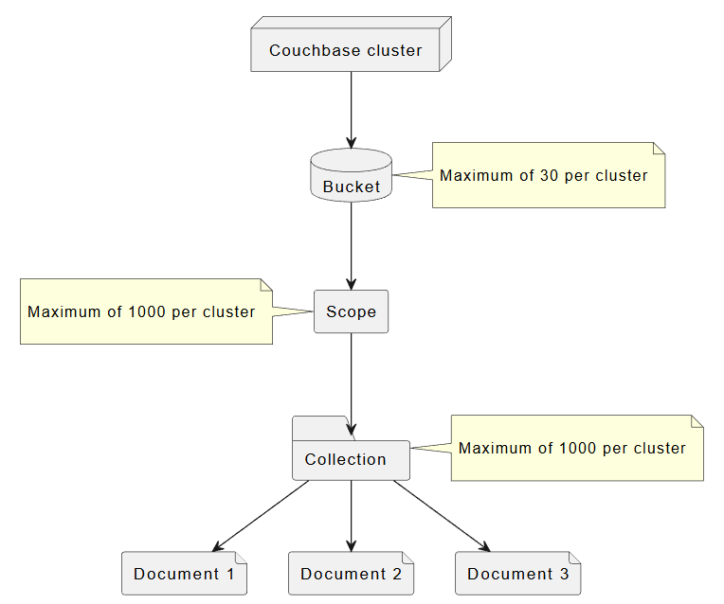
Data Model
Bucket
Scope
Collection
Documents

Slide 61
Bucket
fundamental space for storing data in Couchbase
each bucket contains a hierarchy of scopes and collections
can create up to 30 buckets in a cluste
buckets store data both in memory and on disk; support automatic data replication for high availability

Slide 62
Document
refers to an entry in database (other databases may refer to same concept as a row)
has an ID (primary key in other relational databases), which is unique and by which it can be located - also has a value which contains the actual data
  document IDs (keys) are assigned by application
    valid document ID must:
      conform to UTF-8 encoding
      be no longer than 250 bytes

Slide 63
free to choose any ID (key) for your document, so long as it conforms to restrictions
unlike some other database, Couchbase does not automatically generate IDs for you
documents are usually (but not always) stored as JSON on server
insert will only create document if given ID is not found within database
replace will only replace document if given ID already exists within database
upsert will always replace document, ignoring whether ID already exists or not

Slide 64
can also specify additional options when storing document
  expiry (or TTL) value which will instruct server to delete document after given amount of time; option is useful for transient data (such as sessions); by default, documents do not expire
  CAS value to protect against concurrent updates to same document
to only modify certain parts of document, can use sub-document operations which operate on specific subsets of documents
additional operations for setting document’s expiration without modifying its contents:
  get-and-touch operation
  touch

Slide 65
Scope
stores collections
when create bucket, Couchbase provides you with a default scope called _default

Slide 66
Collection
contains a set of documents
Couchbase provides with default collection called _default

Slide 67
remember …

Slide 68
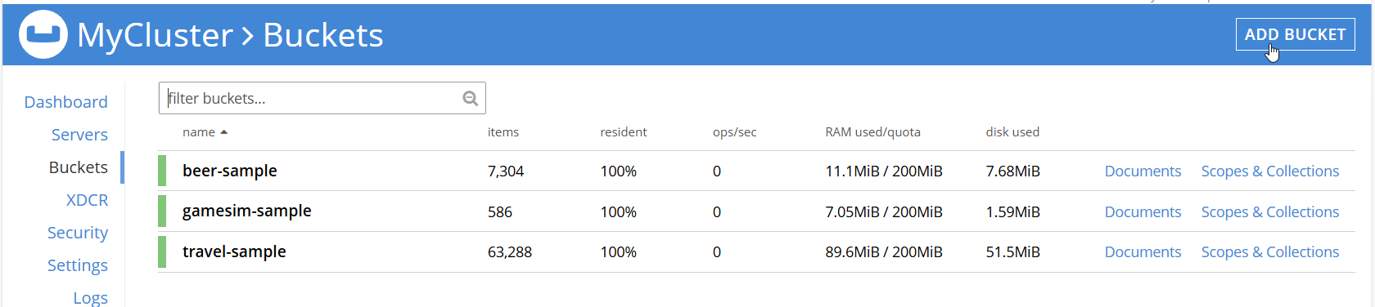
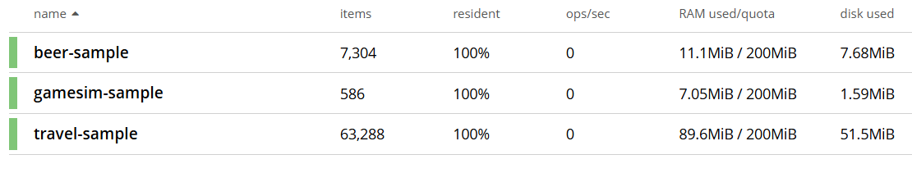

Slide 69
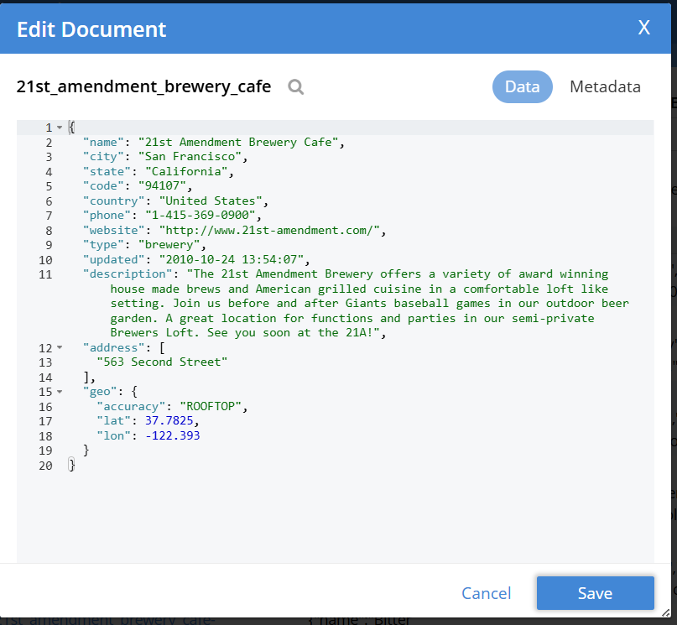

Slide 70
now remember

Slide 72
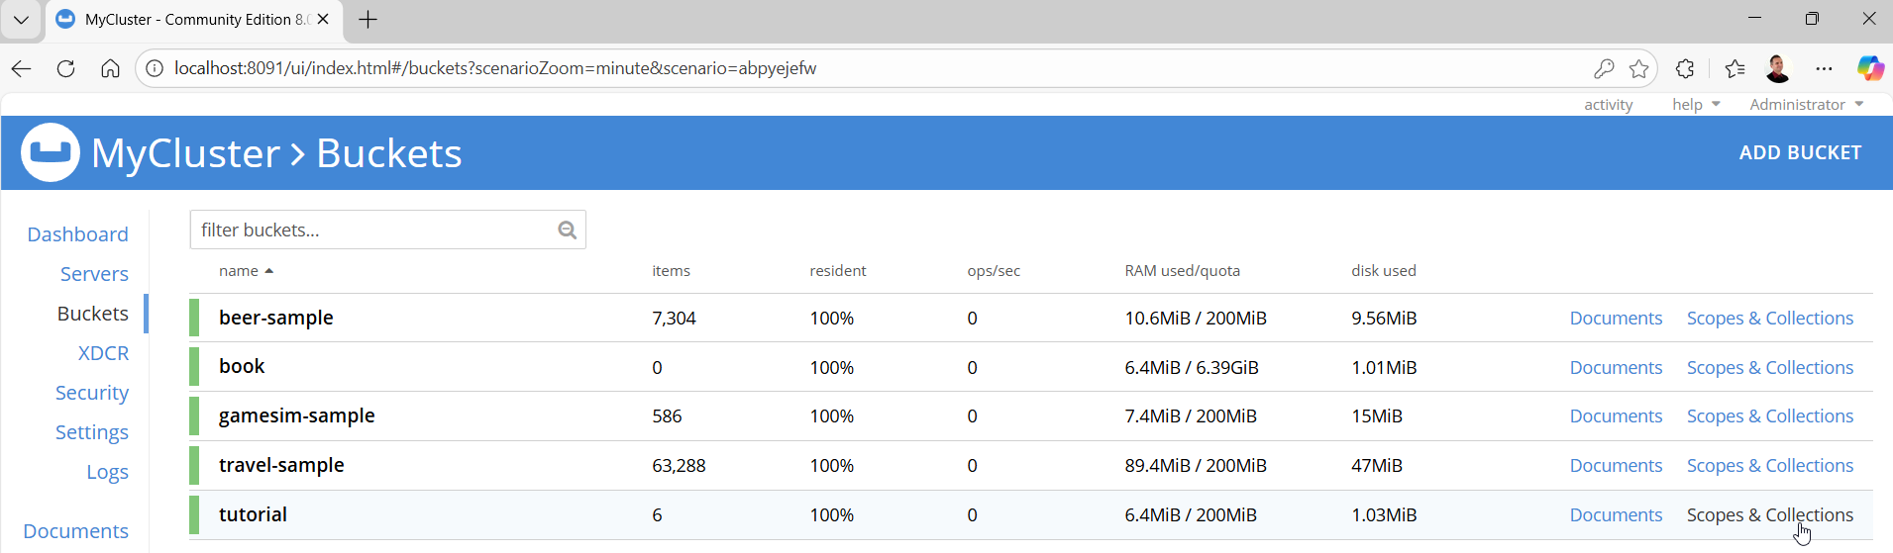
Scope & Collections

Slide 73
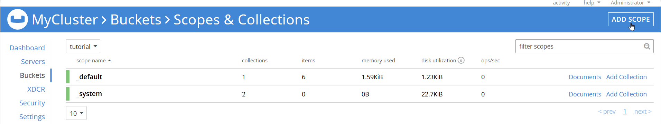
Create Scope click Add Scope, enter name, Save

Slide 74
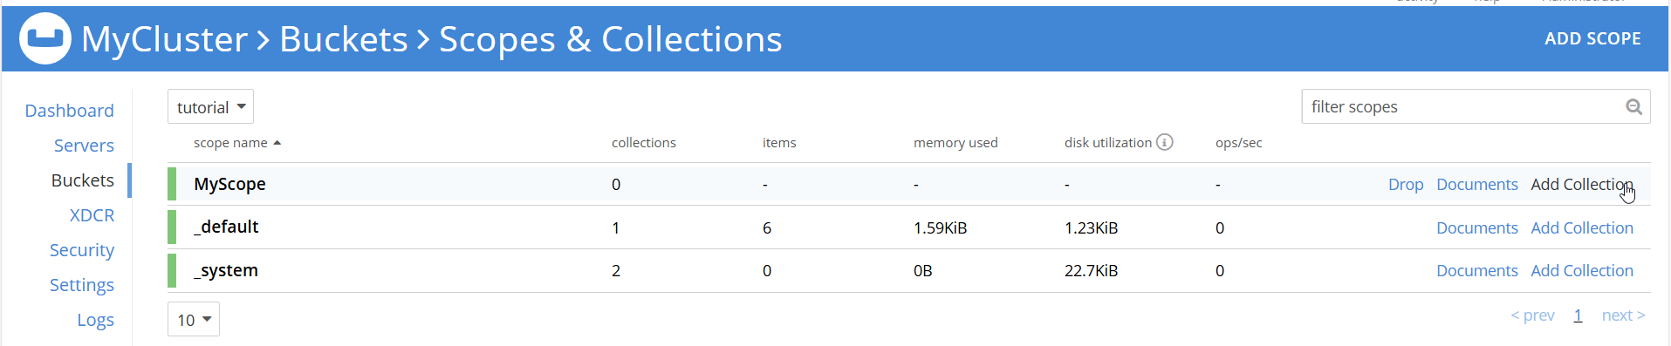
Create Collection click Add Collection, enter name, Save

Slide 75
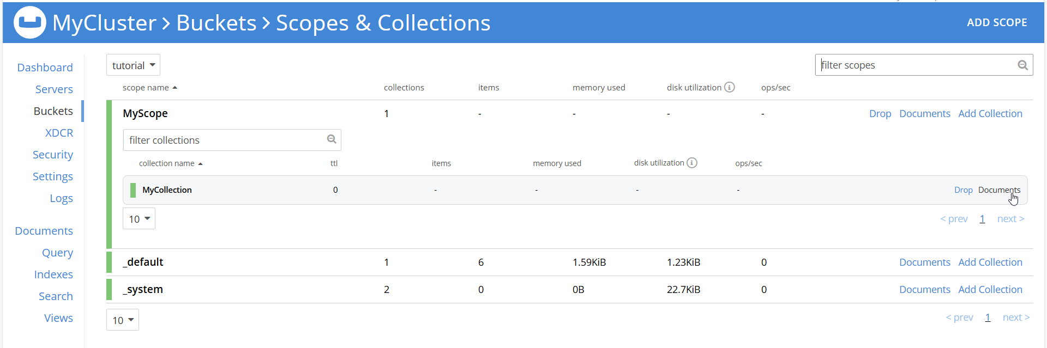
Document

Slide 77
collections allow to use the relational model and the document model at the same time to achieve the best data model design and performance

Slide 78
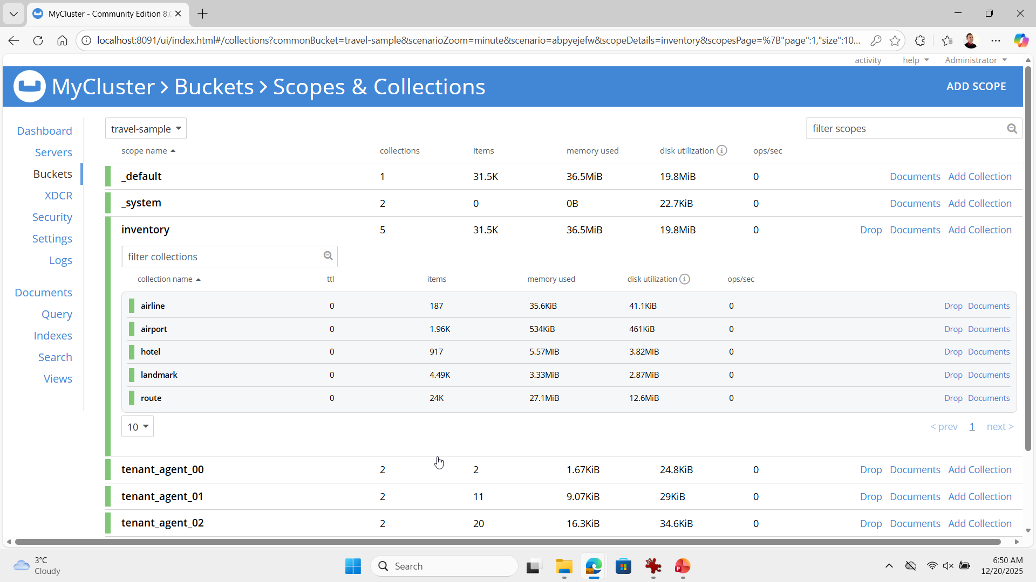

Slide 79
collections allow to use the relational model and the document model at the same time to achieve the best data model design and performance

Slide 80
Query context

Slide 81
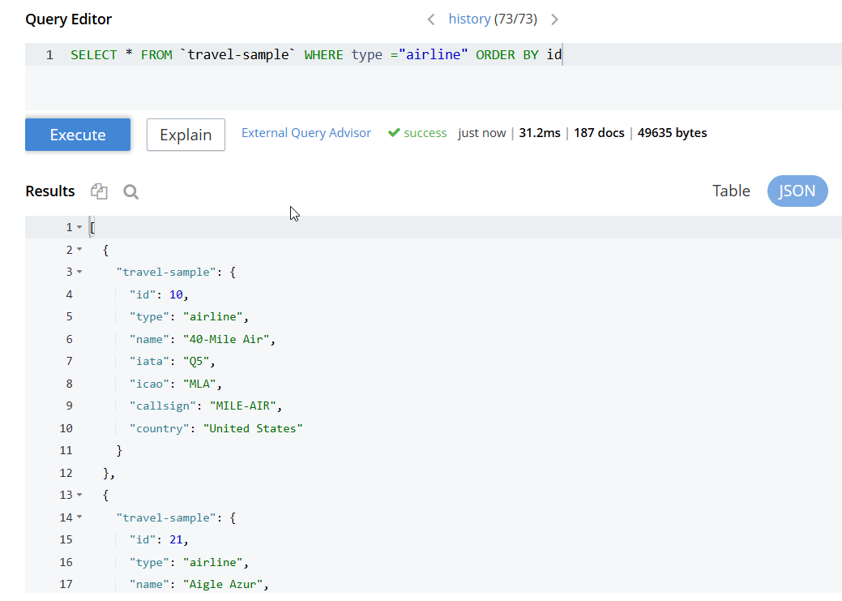
SELECT * FROM `travel-sample` WHERE type ="airline" ORDER BY id

Slide 82
SELECT * FROM `travel-sample`
WHERE type ="airline" ORDER BY id

Slide 83
SELECT * FROM
`travel-sample`.inventory.airline ORDER BY id

Slide 84
SELECT count(*) FROM `travel-sample` WHERE type = "airline"
SELECT count(*) FROM `travel-sample`.inventory.airline
[ { "$1": 187 }]
[ { "$1": 187 }]

Slide 85
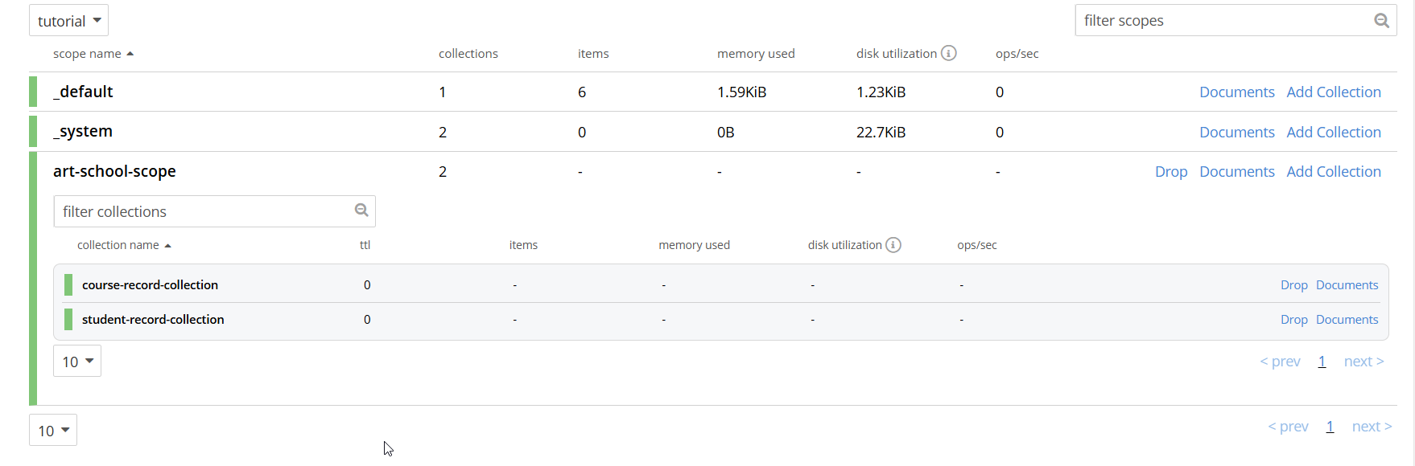

Slide 86
Query context

Slide 87
select collection in context

Slide 88
no context at all
context: unset

Slide 89
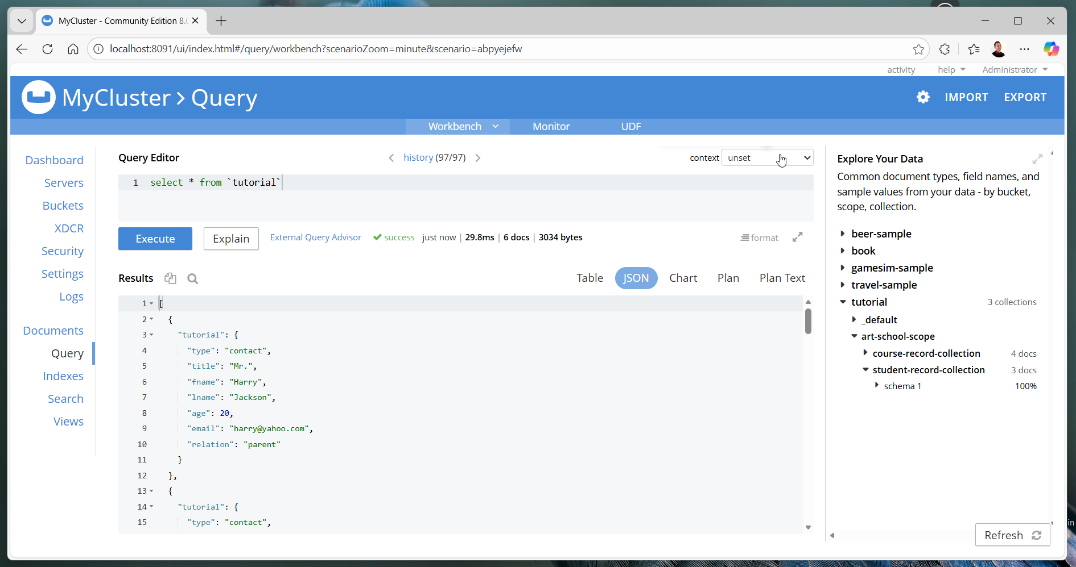

Slide 90
context
bucket
scope

Slide 91
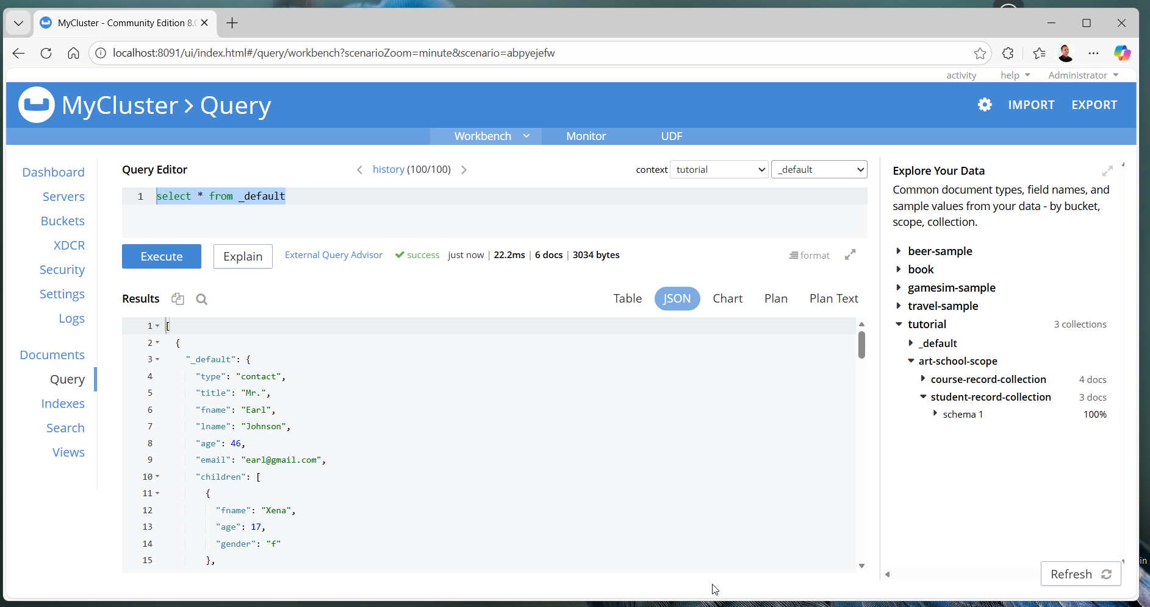

Slide 93
context
bucket: tutorial
scope: art-school-scope

Slide 94
select * from `student-record-collection`
[ { "student-record-collection": { "student-id": 1, "enrollments": [ { "course-id": 3, "final-score": null, "date-enrolled": "2024-04-18", "date-completed": null }, { "course-id": 1, "final-score": null, "date-enrolled": "2025-03-05", "date-completed": null } ], "student-name": "Harriet Hill", "date-of-birth": "1970-03-06" } },
{ "student-record-collection": { "student-id": 3, "enrollments": [ { "course-id": null, "final-score": null, "date-enrolled": null, "date-completed": null } ], "student-name": "Jenny Mills", "date-of-birth": "1969-11-06" } },
{ "student-record-collection": { "student-id": 2, "enrollments": [ { "course-id": 1, "final-score": null, "date-enrolled": "2025-03-01", "date-completed": null } ], "student-name": "Steven Morris", "date-of-birth": "1984-03-05" } }]

Slide 95
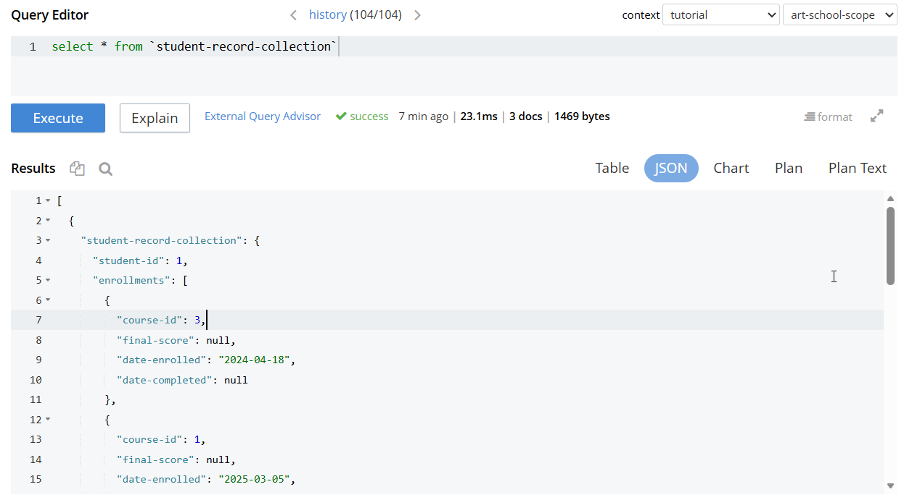

Slide 96
select * from `course-record-collection`
[ { "course-record-collection": { "faculty": "English", "course-id": 4, "course-name": "Creative Writing", "credit-points": 70 } },
{ "course-record-collection": { "faculty": "Art", "course-id": 1, "course-name": "Art History", "credit-points": 50 } },
{ "course-record-collection": { "faculty": "Art", "course-id": 2, "course-name": "Fine Art", "credit-points": 30 } },
{ "course-record-collection": { "faculty": "Design", "course-id": 3, "course-name": "Graphic Design", "credit-points": 70 } }]

Slide 97
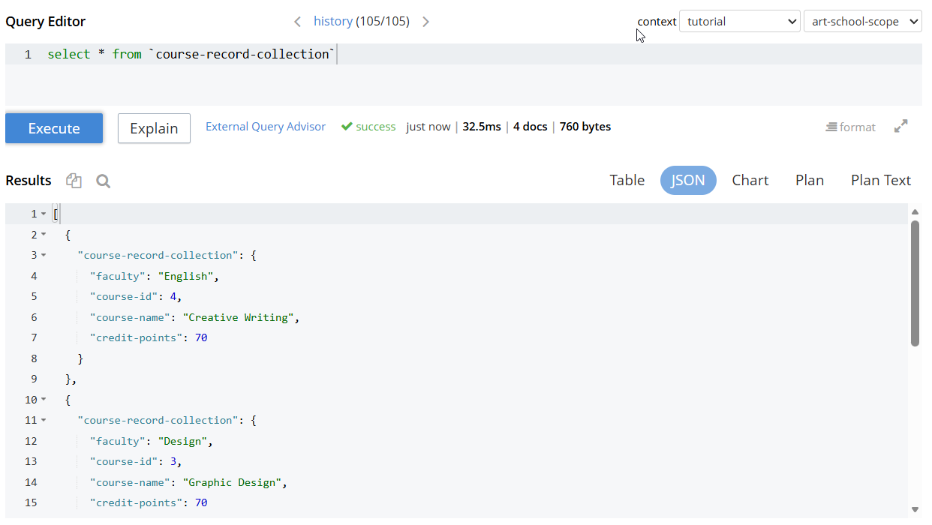

Slide 98
N1QL Query Join

Slide 99
Most N1QL queries will be in following format:
SELECT [DISTINCT] <expression>
FROM <data source>
WHERE <expression>
GROUP BY <expression>
ORDER BY <expression>
LIMIT <number> OFFSET <number>

Slide 100
Join
to assemble new objects by combining two or more source objects
for example, suppose there are two bucket’s collections: users and cities with users – users contains user profiles along with city Ids of the city that they live on – cities contains description of particular city
can use JOIN clause to view user-profile along with city details

Slide 101
Join
when use JOIN clause without specifying any quantifier, it will perform an inner join, which means that it will select only those documents from left side of join that have a matching key with that on right side

Slide 102
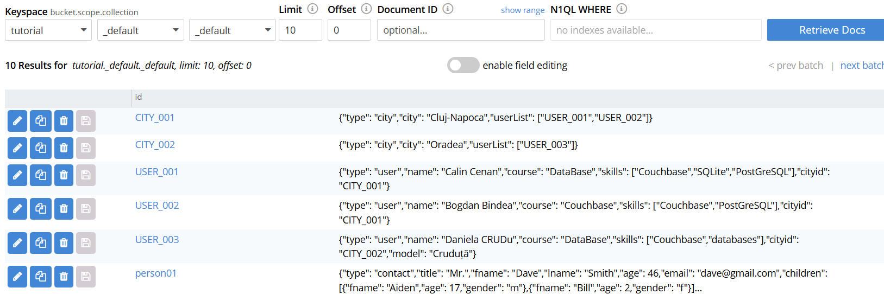

Slide 103
SELECT * FROM `tutorial` utilizatori
LEFT OUTER JOIN `tutorial` cities ON keys utilizatori.cityid
WHERE utilizatori.type="user"
ORDER BY cities.city, utilizatori.name

Slide 104
[ { "cities": { "city": "Cluj-Napoca", "type": "city", "userList": [ "USER_001", "USER_002" ] }, "utilizatori": { "type": "user", "name": "Bogdan Bindea", "course": "Couchbase", "skills": [ "Couchbase", "PostGreSQL" ], "cityid": "CITY_001" } },
{"cities": { "city": "Cluj-Napoca", "type": "city", "userList": [ "USER_001", "USER_002" ] }, "utilizatori": { "type": "user", "name": "Calin Cenan", "course": "DataBase", "skills": [ "Couchbase", "SQLite", "PostGreSQL" ], "cityid": "CITY_001" } },
{"cities": { "type": "city", "city": "Oradea", "userList": [ "USER_003" ] }, "utilizatori": { "type": "user", "name": "Daniela CRUDu", "course": "DataBase", "skills": [ "Couchbase", "databases" ], "cityid": "CITY_002", "model": "Cruduță" } }]

Slide 105
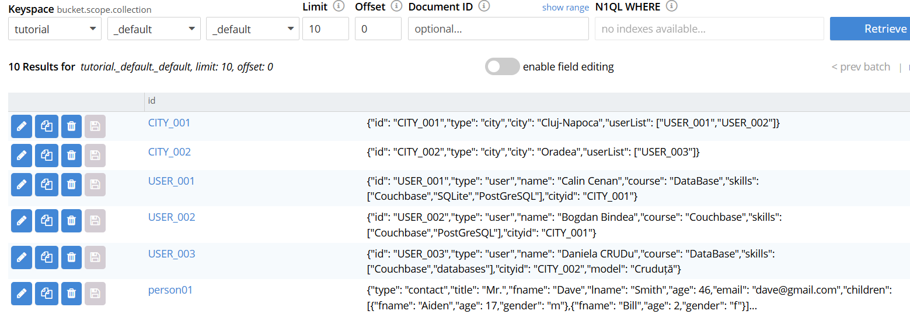

Slide 106
SELECT * FROM `tutorial` utilizatori
LEFT OUTER JOIN `tutorial` cities ON utilizatori.cityid = cities.id
WHERE utilizatori.type="user"
ORDER BY cities.city, utilizatori.name

Slide 107
[ { "cities": { "city": "Cluj-Napoca", "id": "CITY_001", "type": "city", "userList": [ "USER_001", "USER_002" ] }, "utilizatori": { "id": "USER_002", "type": "user", "name": "Bogdan Bindea", "course": "Couchbase", "skills": [ "Couchbase", "PostGreSQL" ], "cityid": "CITY_001" } },
{ "cities": { "city": "Cluj-Napoca", "id": "CITY_001", "type": "city", "userList": [ "USER_001", "USER_002" ] }, "utilizatori": { "id": "USER_001", "type": "user", "name": "Calin Cenan", "course": "DataBase", "skills": [ "Couchbase", "SQLite", "PostGreSQL" ], "cityid": "CITY_001" } },
{ "cities": { "city": "Oradea", "id": "CITY_002", "type": "city", "userList": [ "USER_003" ] }, "utilizatori": { "id": "USER_003", "type": "user", "name": "Daniela CRUDu", "course": "DataBase", "skills": [ "Couchbase", "databases" ], "cityid": "CITY_002", "model": "Cruduță" } }]

Slide 108
SELECT * FROM `tutorial` cities
LEFT OUTER JOIN `tutorial` utilizatori ON utilizatori.cityid = cities.id
WHERE utilizatori.type="user"
ORDER BY cities.city, utilizatori.name

Slide 109
[ { "cities": { "id": "CITY_001", "type": "city", "city": "Cluj-Napoca", "userList": [ "USER_001", "USER_002" ] }, "utilizatori": { "cityid": "CITY_001", "course": "Couchbase", "id": "USER_002", "name": "Bogdan Bindea", "skills": [ "Couchbase", "PostGreSQL" ], "type": "user" } },
{ "cities": { "id": "CITY_001", "type": "city", "city": "Cluj-Napoca", "userList": [ "USER_001", "USER_002" ] }, "utilizatori": { "cityid": "CITY_001", "course": "DataBase", "id": "USER_001", "name": "Calin Cenan", "skills": [ "Couchbase", "SQLite", "PostGreSQL" ], "type": "user" } },
{ "cities": { "id": "CITY_002", "type": "city", "city": "Oradea", "userList": [ "USER_003" ] }, "utilizatori": { "cityid": "CITY_002", "course": "DataBase", "id": "USER_003", "model": "Cruduță", "name": "Daniela CRUDu", "skills": [ "Couchbase", "databases" ], "type": "user" } }]

Slide 110
NEST
performs a join across two bucket’s collections, but instead of producing an object for each combination of left and right hand inputs, NEST produces a single object for each left hand input, while the corresponding right hand inputs are collected into array and nested as single array-valued field in the result object
similar to JOIN, NEST also supports LEFT [ OUTER ] NEST

Slide 111
UNNEST
creates an input object by flattening array in parent document
if document or object contains a nested array, UNNEST conceptually performs join of nested array with its parent object; each resulting joined object becomes an output of query
JOIN, NEST, and UNNEST can be chained and combined, in any order, as many times as desired.

Slide 112
SELECT * FROM `tutorial` cities
UNNEST cities.userList utilizator
WHERE cities.type="city"
ORDER BY cities.city, utilizator

Slide 113
[ { "cities": { "id": "CITY_001", "type": "city", "city": "Cluj-Napoca", "userList": [ "USER_001", "USER_002" ] }, "utilizator": "USER_001" },
{ "cities": { "id": "CITY_001", "type": "city", "city": "Cluj-Napoca", "userList": [ "USER_001", "USER_002" ] }, "utilizator": "USER_002" },
{ "cities": { "id": "CITY_002", "type": "city", "city": "Oradea", "userList": [ "USER_003" ] }, "utilizator": "USER_003" }]

